Slide 1
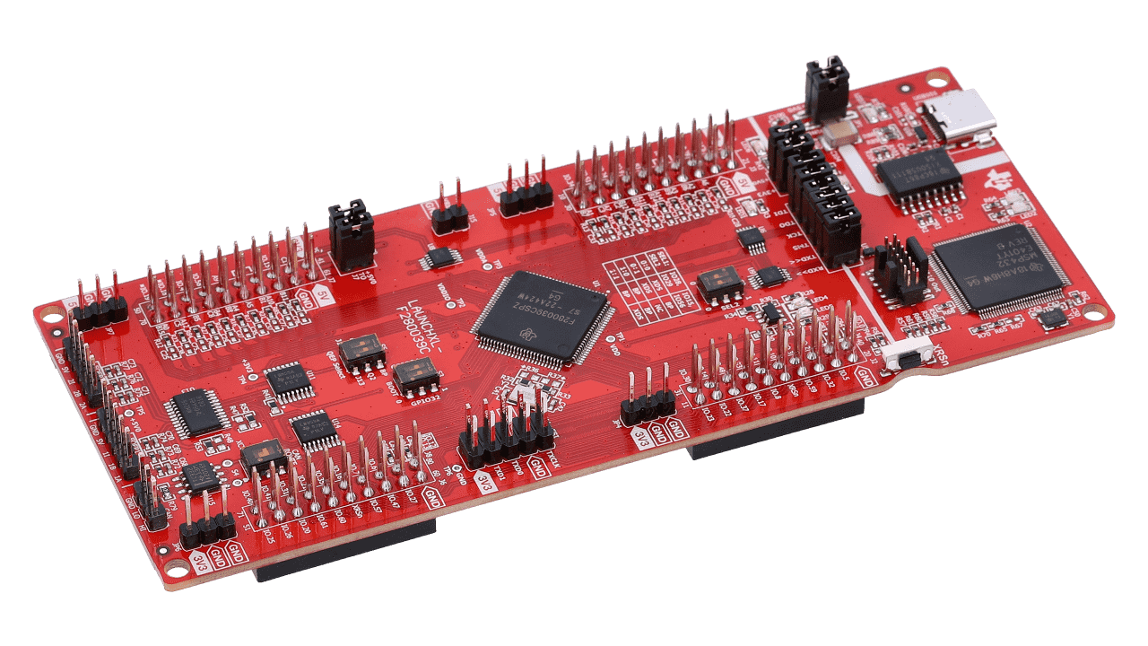

ECEN 404 Final Presentation
Team 1: ADC Resolution vs. Sensorless Motor Control Performance
Cristian Ornelas, Tyler Hawkins, Tamara Basfar, John King Sponsor: Kevin Allen (Texas Instruments) TA: Fahrettin Ay

Slide 2
Problem Overview
Problem: How do different configurations of sensorless motor control affect performance?
Solution: Port the universal motor control software to one of TI’s newest c2000 devices. Develop updated configurations of the universal solution, and test the effects on sensorless control performance.

Slide 3
What We Are Testing
8 Total Configurations
Float 32 operations Vs Float 64 operations
12 bit ADC Vs 16 bit ADC
No Oversampling Vs Oversampling

Slide 4
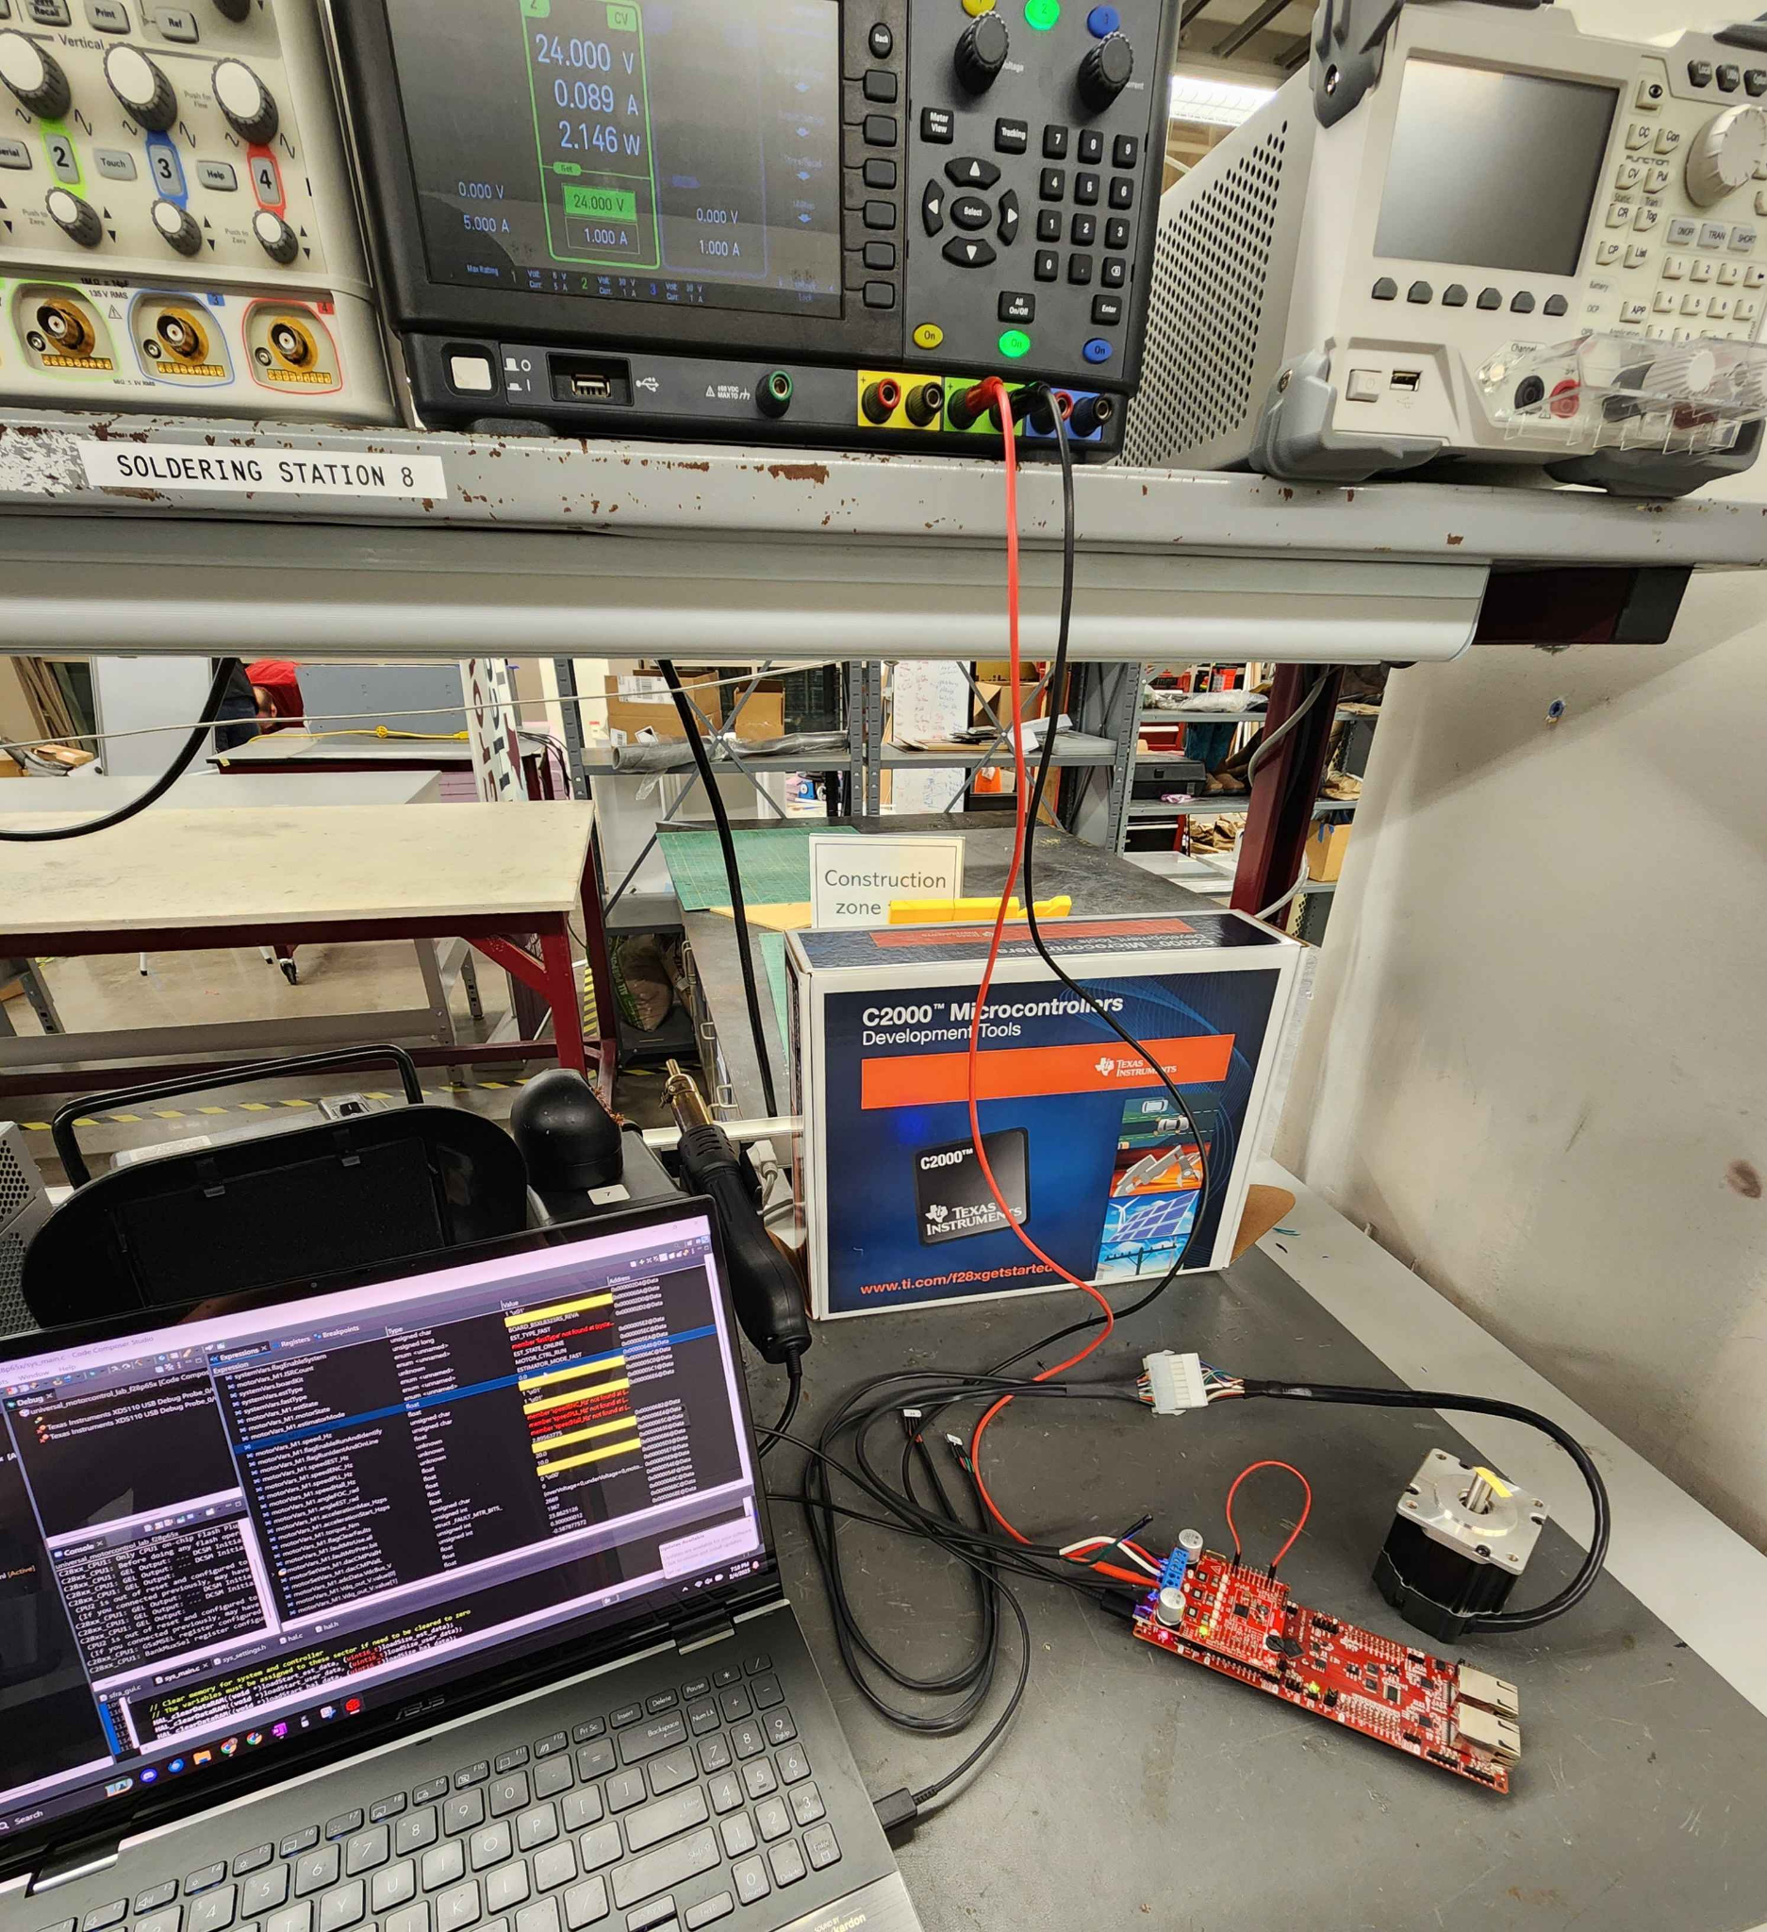
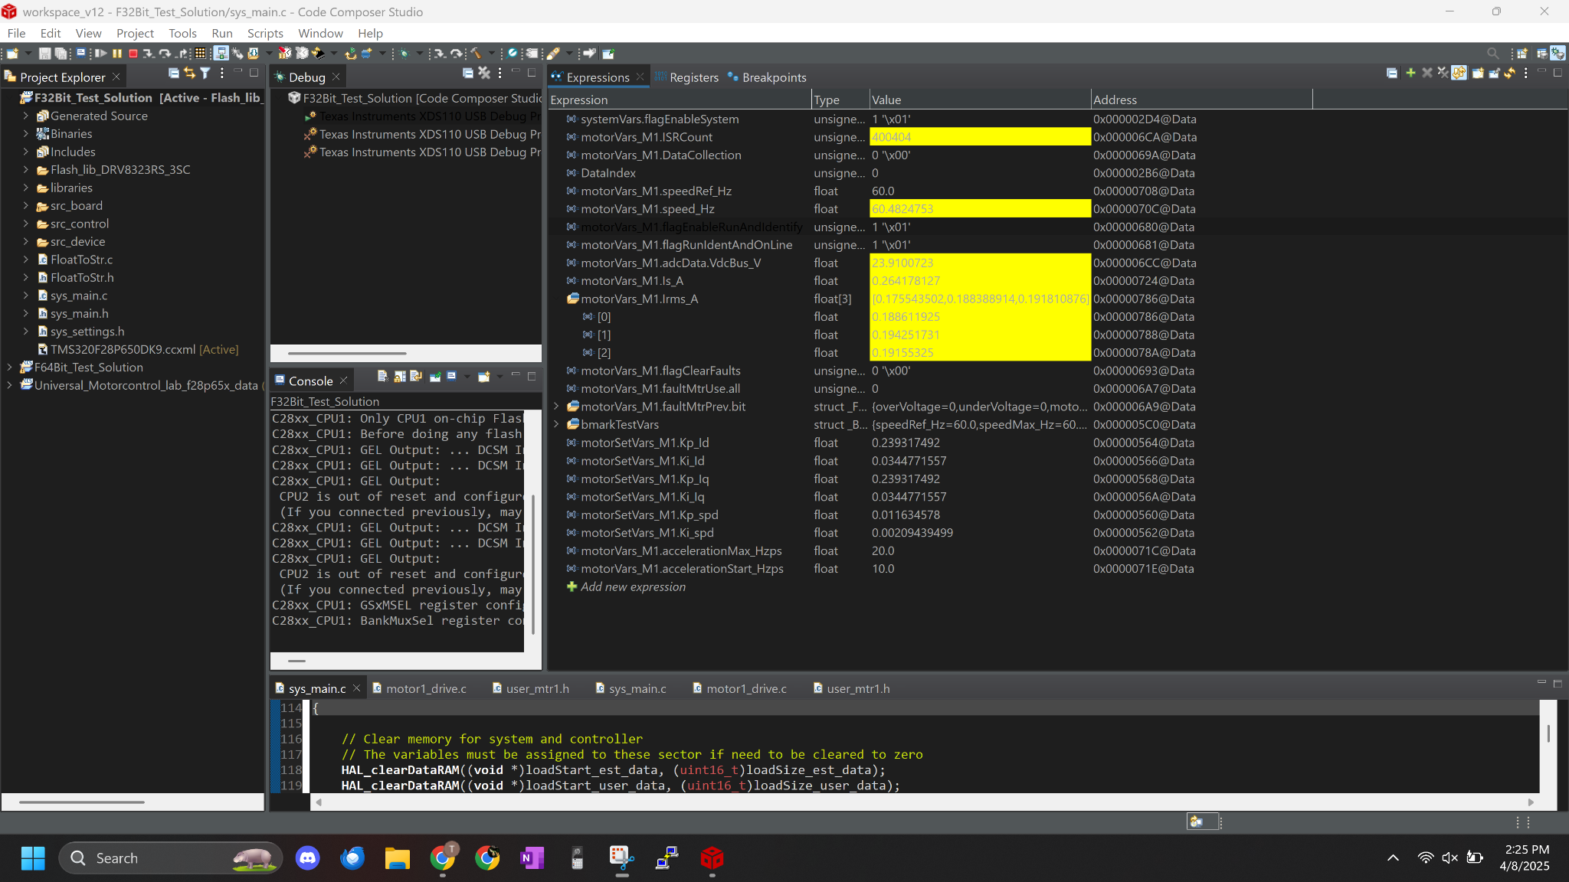
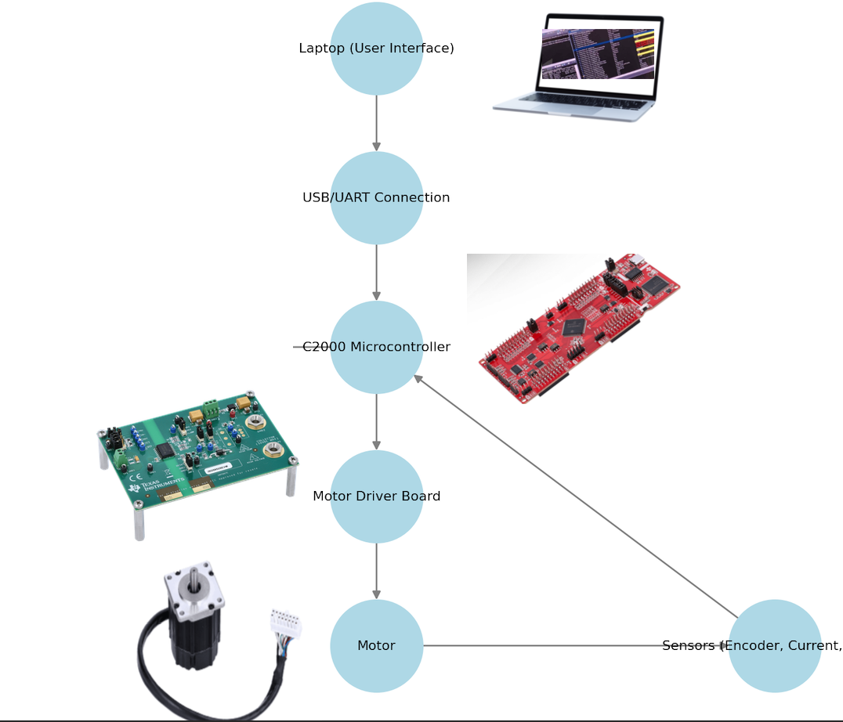
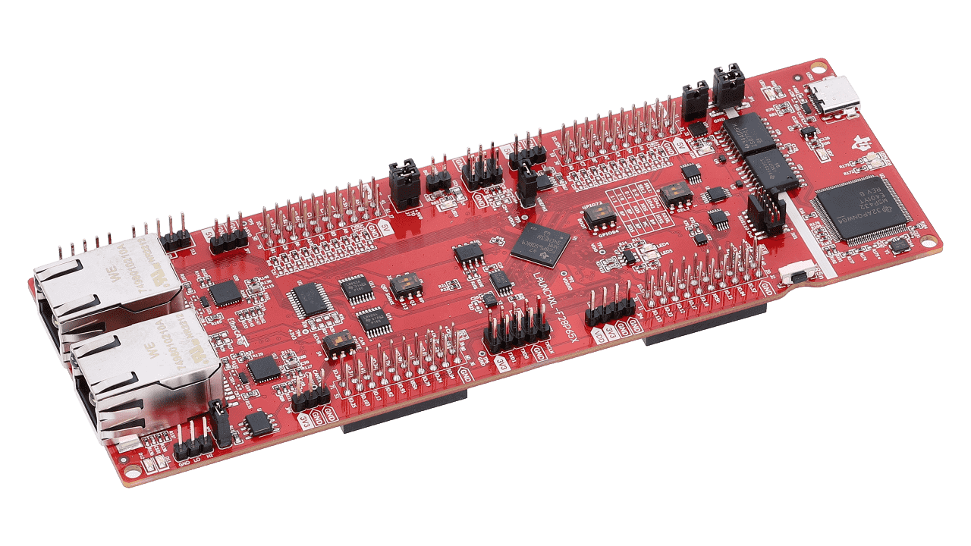
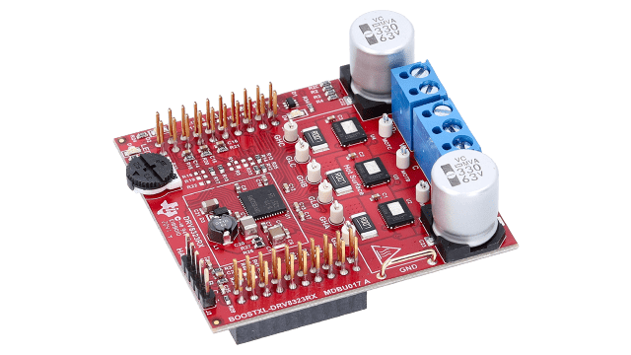
Integrated System Diagram
Notes:
Low voltage servo motor

Slide 5
Solution Porting & Data Collection
-Tyler Hawkins

Slide 6
Engineering Design Accomplishments
Solution Porting & Data Collection
Ported over the full Universal Motor Control solution to the F28P65X Launchpad and DRV8323 Driver board from F28002X
Verified ported solution using TI’s Universal Motor Control specifications
Developed and tested a method of data collection for system testing
Redesigned and 3d printed Brake mount for load testing

Slide 7
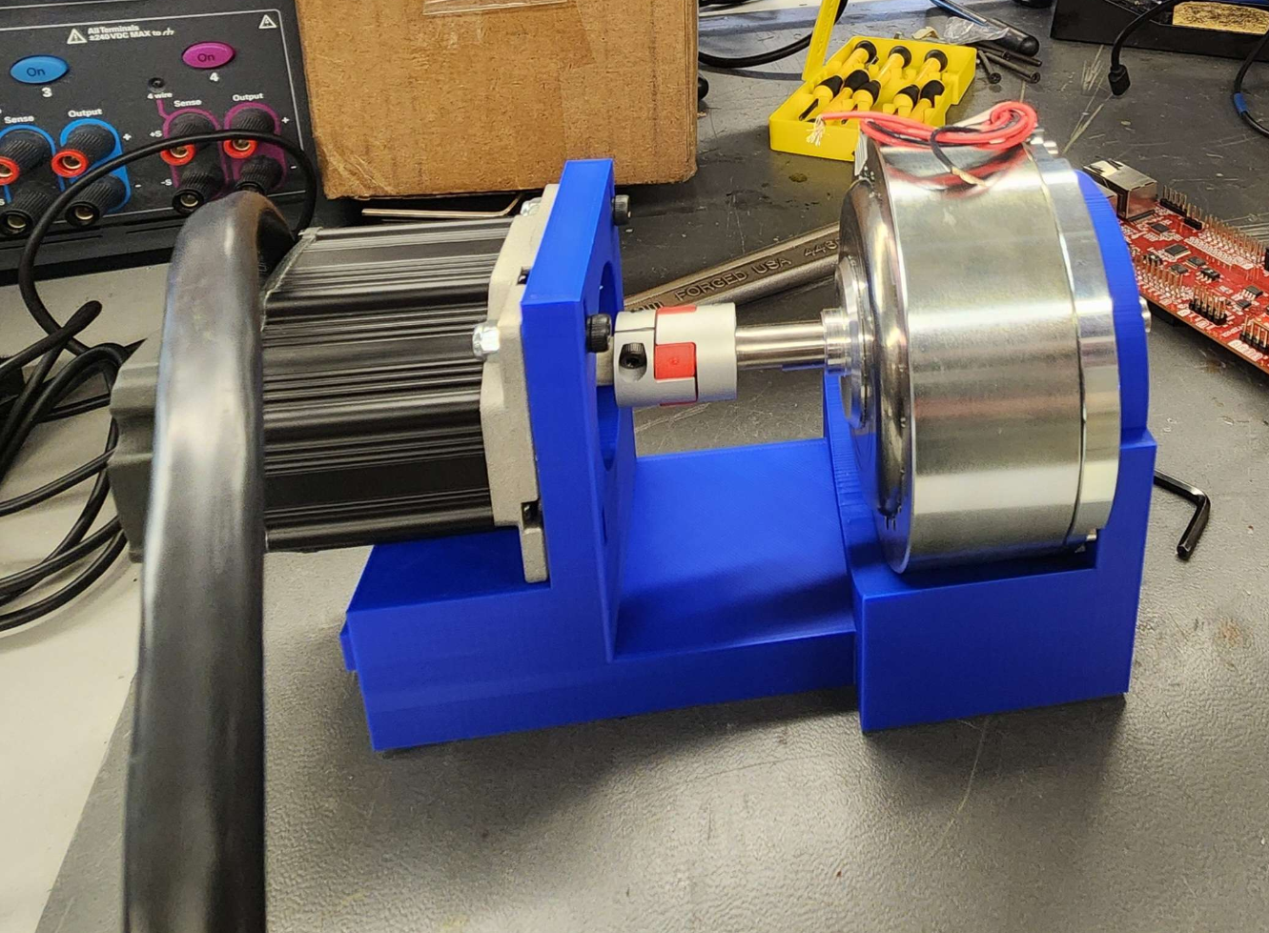
Engineering Design Accomplishments
Solution Porting & Data Collection
Data is sent over UART using Putty
115200 Baud Rate
Collects data point every 1 ms for 30s for a total of 30,000 data points

Slide 8
Estimator & Float 64 Estimator Update
-John King

Slide 9
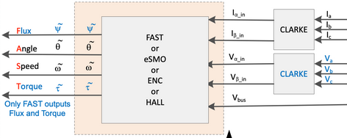
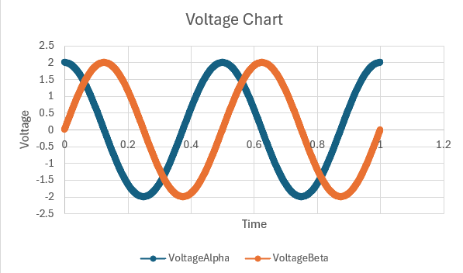
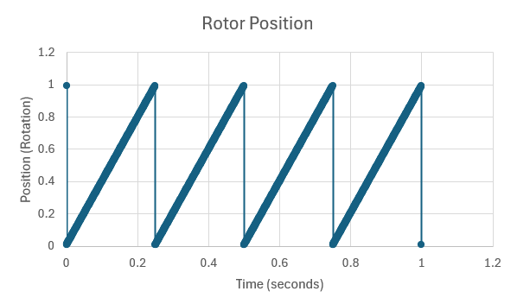
Engineering Design Accomplishments
Estimator subsystem
Developed Estimator control code
Achieved accurate prediction of motor orientation based on back voltage input.

Slide 10
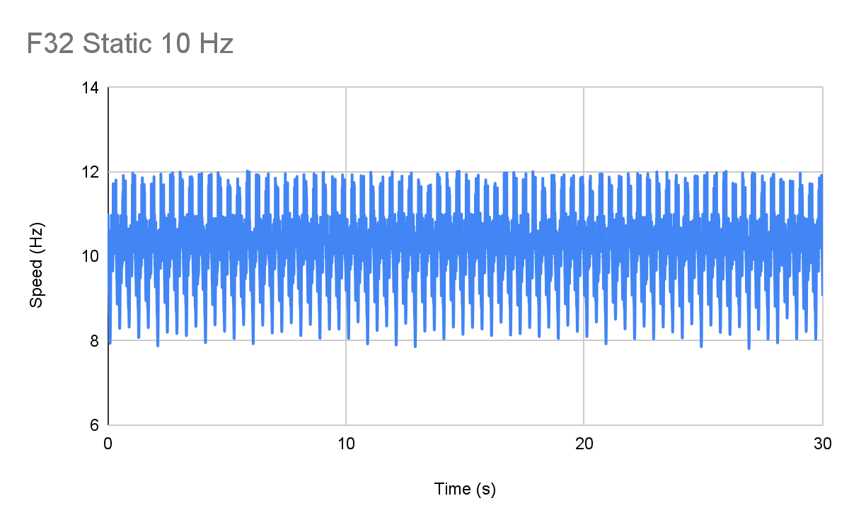
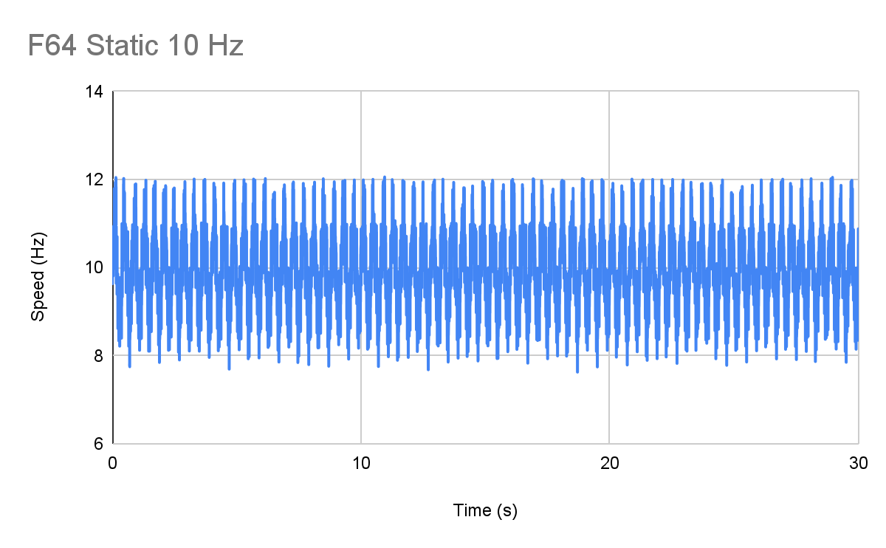
Engineering Design Accomplishments
Float 64 Estimator Update
Modified the estimator code to run float 64 calculations instead of float 32.
Tested and verified that the updated code functioned as intended and utilized correct values.
F32 Max. | F32 Min. | F32 Avg. | σ
11.999 | 7.814 | 10.053 | 0.826
F64 Max. | F64 Min. | F64 Avg. | σ
11.999 | 7.6345 | 10.044 | 0.756

Slide 11
PWM & Oversampling
-Tamara Basfar

Slide 12
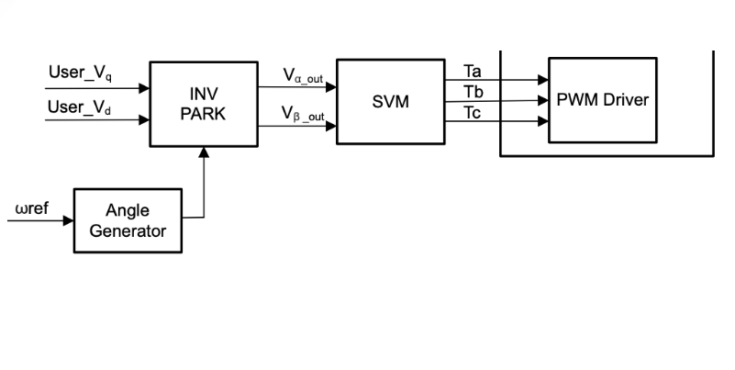
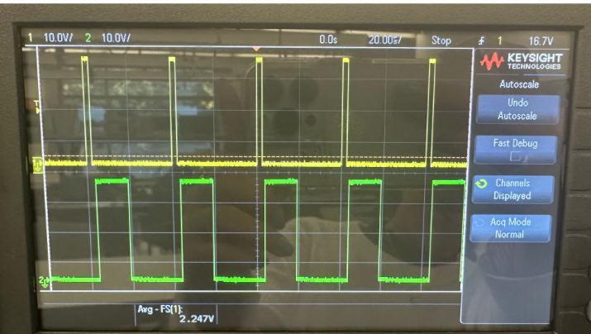
Engineering Design Accomplishments
PWM subsystem
Developed PWM control path
Achieved precise timing, resolution, and safe switching
Validated frequency, duty cycle, and dead-time
Requirement | Spec | Measured Performance
PWM frequency | 20 kHz | 20.02 kHz (±0.1%)
Duty cycle resolution | ≤1% error | Measured 0.6% max error
Dead-time insertion | ≥500ns | Verified at 520ns

Slide 13
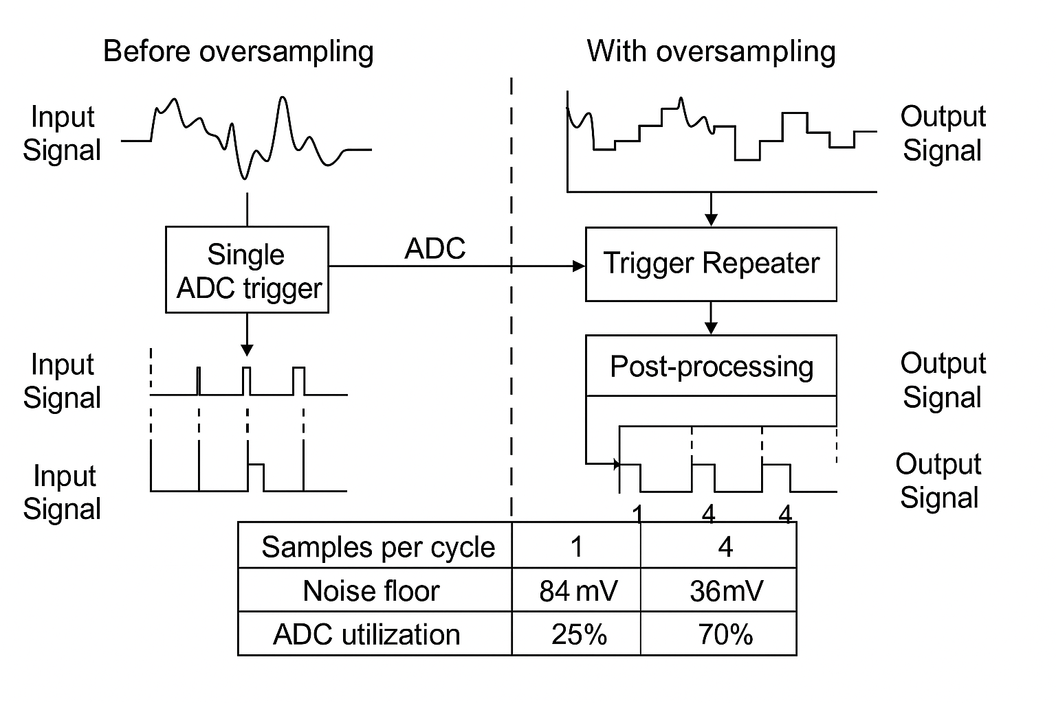
Engineering Design Accomplishments
oversampling update
Implemented ADC oversampling using trigger repeater
In individual example cut current sense noise floor by 57%
Added post-processing to reduce CPU load
ADC utilization increased

Slide 14
ADC & 12 bit vs 16 Resolution
-Cristian Ornelas

Slide 15
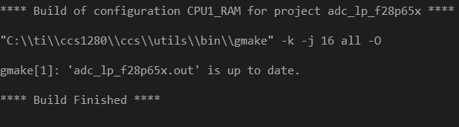
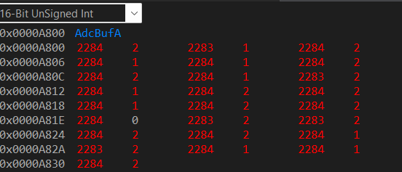
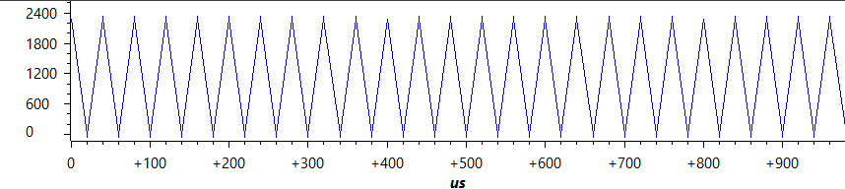
Engineering Design Accomplishments
ADC Subsystem
Developed an ADC Module that properly converts analog to digital signals
Validated the behavior of the ADC module using TI’s code composer waveform and LED lights on the F28P65x board.
Task | Specification | Result
Buffer | The memory result buffer will show the behavior of ADC A | The ADC will toggle the values in the 12-bit memory buffer from 4095 to 0
LED | LED 4 show the behavior of the GPIO pin on the f28p65x board | The LED 4 will blink on and off as ADC A is converting

Slide 16
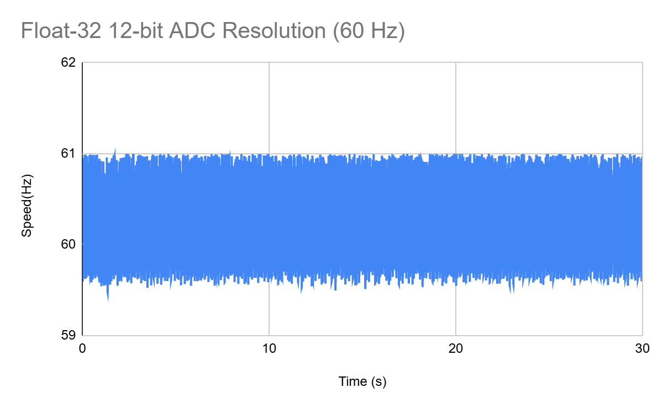
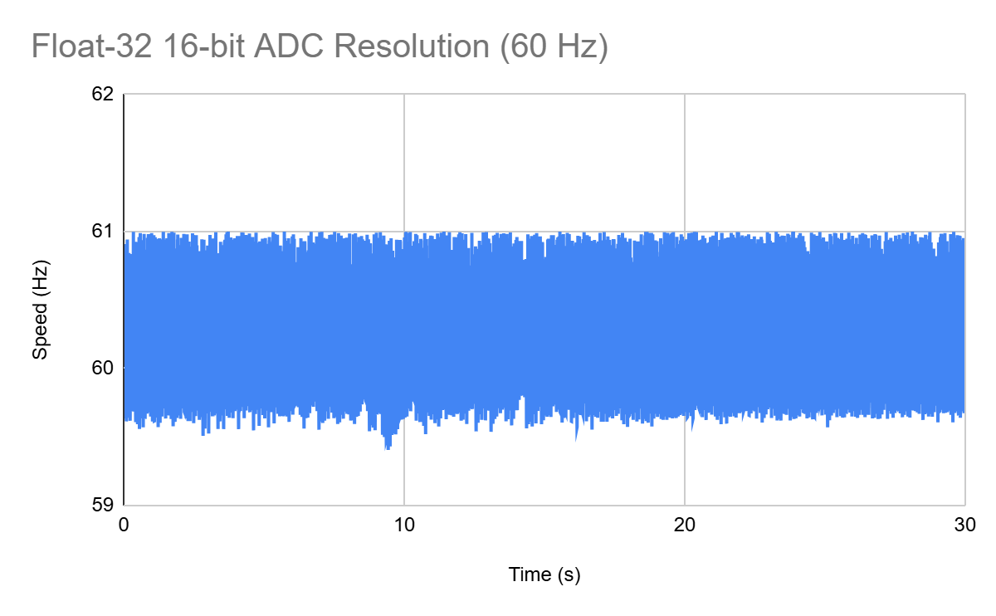
Engineering Design Accomplishments
12/16 ADC Resolution Update
Modified software to run 12-bit and 16-bit ADC resolution interchangeably.
Validated the update to show that the correct current and voltage values were appearing: along with the sensorless motor spinning properly.
Max | 60.999 Hz
Min | 59.475 Hz
Avg | 60.107 Hz
σ | 0.3376
Max | 60.999 Hz
Min | 59.406 Hz
Avg | 60.092 Hz
σ | 0.3192

Slide 17
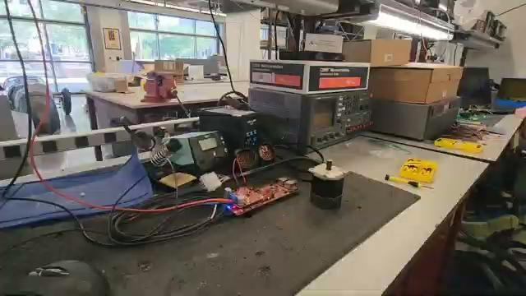

Slide 18
Static Speed Performance
60 Hz
Configuration | Maximum | Minimum | Average | σ
F32 | 60.999 | 59.475 | 60.106 | 0.337
F32+OS | 60.999 | 59.4569 | 60.09 | 0.334
F32+16 | 60.999 | 59.406 | 60.091 | 0.319
F32+OS+16 | 60.999 | 59.4667 | 60.092 | 0.324
F64 | 60.999 | 59.6218 | 60.099 | 0.289
F64+OS | 60.999 | 59.508 | 60.096 | 0.293
F64+16 | 60.999 | 59.1609 | 60.097 | 0.301
F64+OS+16 | 60.999 | 59.1618 | 60.096 | 0.302

Slide 19
Static Speed Performance
300 Hz
Configuration | Maximum | Minimum | Average | σ
F32 | 300.999 | 299.754 | 300.21 | 0.315
F32+OS | 301.815 | 298.579 | 300.147 | 0.365
F32+16 | 300.999 | 297.925 | 300.156 | 0.374
F32+OS+16 | 301.212 | 298.775 | 300.131 | 0.352
F64 | 300.999 | 299.46 | 300.192 | 0.328
F64+OS | 300.999 | 298.685 | 300.162 | 0.323
F64+16 | 300.999 | 299.199 | 300.098 | 0.335
F64+OS+16 | 301.898 | 298.796 | 300.058 | 0.367

Slide 20
Static Speed Performance
10 Hz
Configuration | Maximum | Minimum | Average | σ
F32 | 11.999 | 7.814 | 10.053 | 0.826
F32+OS | 11.998 | 7.425 | 10.043 | 0.991
F32+16 | 11.994 | 8.267 | 10.049 | 0.735
F32+OS+16 | 11.997 | 7.205 | 10.037 | 1.064
F64 | 11.999 | 7.634 | 10.044 | 0.755
F64+OS | 11.998 | 7.693 | 10.05 | 0.751
F64+16 | 11.998 | 7.689 | 10.051 | 0.765
F64+OS+16 | 11.998 | 8.434 | 10.043 | 0.684

Slide 21
Speed Step Performance
Speed was Increased every 6 seconds
60 Hz > 300 Hz in 60 Hz steps

Slide 22
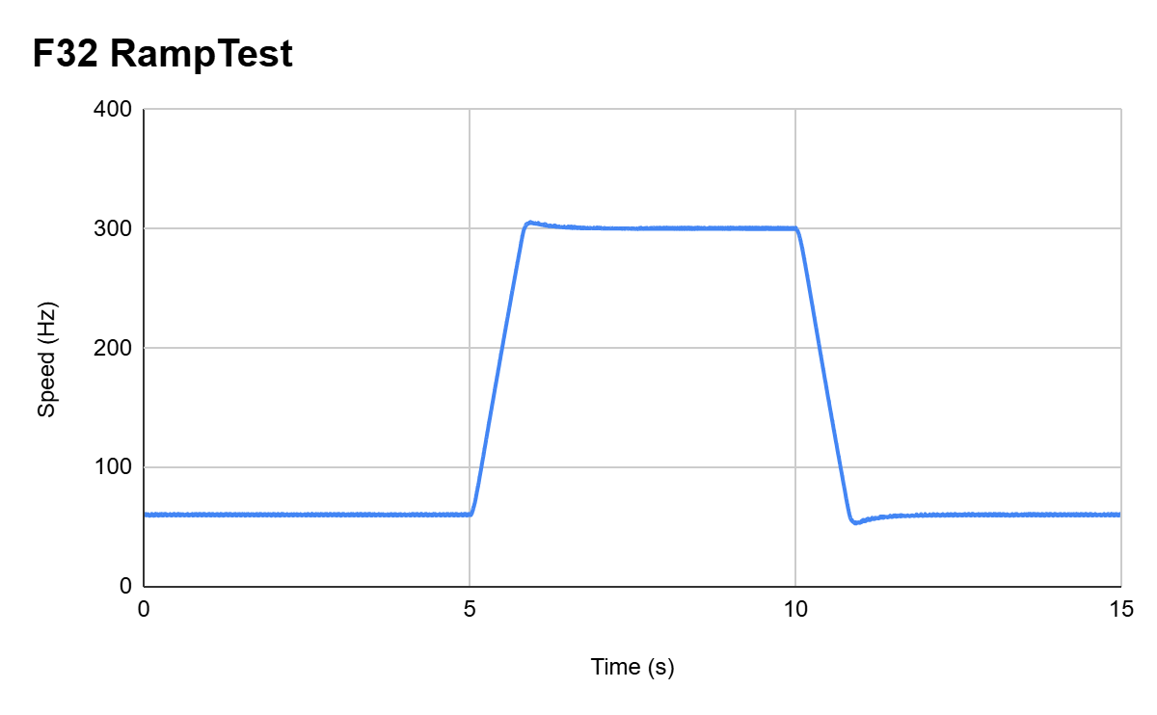

Slide 23
Ramp Test
Configuration | Maximum | Minimum | Settle Time High | Settle Time Low
F32 | 305.965 | 53.1142 | 1.785 | 1.162
F32+OS | 305.967 | 53.2151 | 1.79 | 1.144
F32+16 | 304.827 | 53.6545 | 1.86 | 1.267
F32+OS+16 | 305.952 | 53.2506 | 1.854 | 1.268
F64 | 306.923 | 52.316 | 1.91 | 1.152
F64+OS | 306.976 | 52.1243 | 1.743 | 1.311
F64+16 | 306.869 | 51.938 | 1.713 | 1.124
F64+OS+16 | 306.89 | 51.6726 | 1.667 | 1.257

Slide 24
Increasing Load Performance
Load was Increased every 5 seconds with use of a hysteresis brake and variable power supply

Slide 25
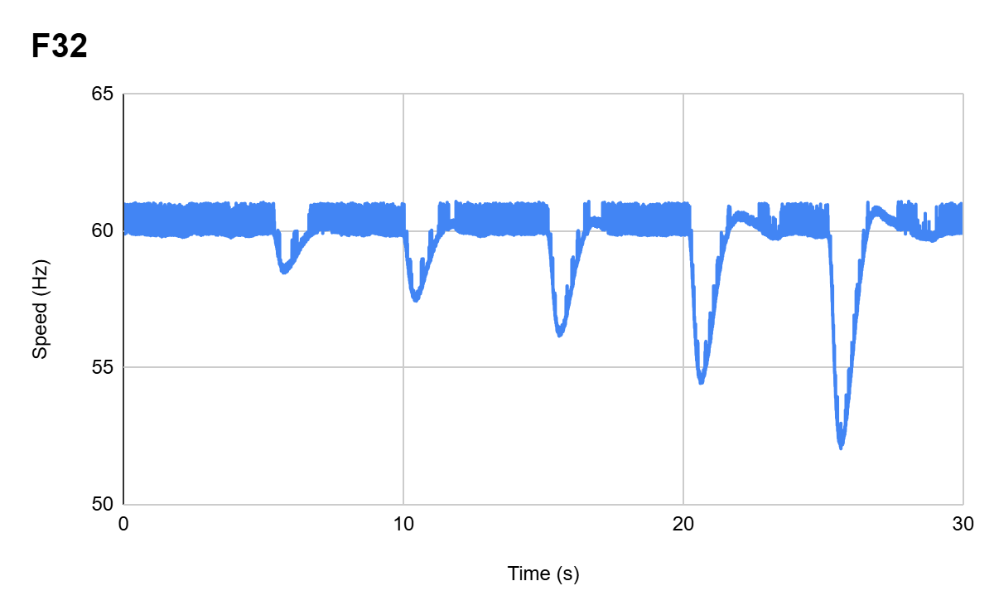

Slide 26
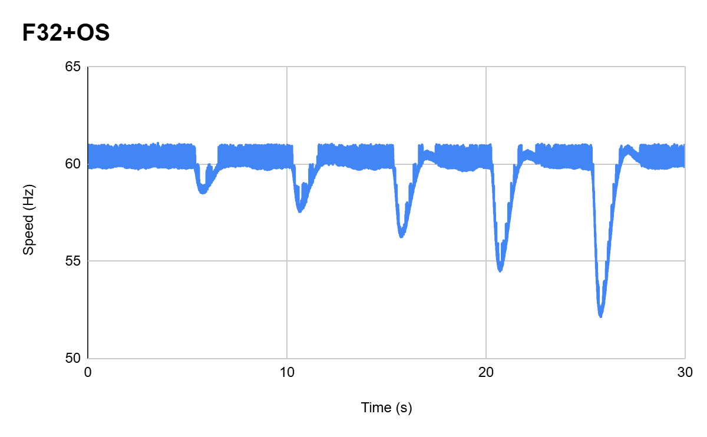
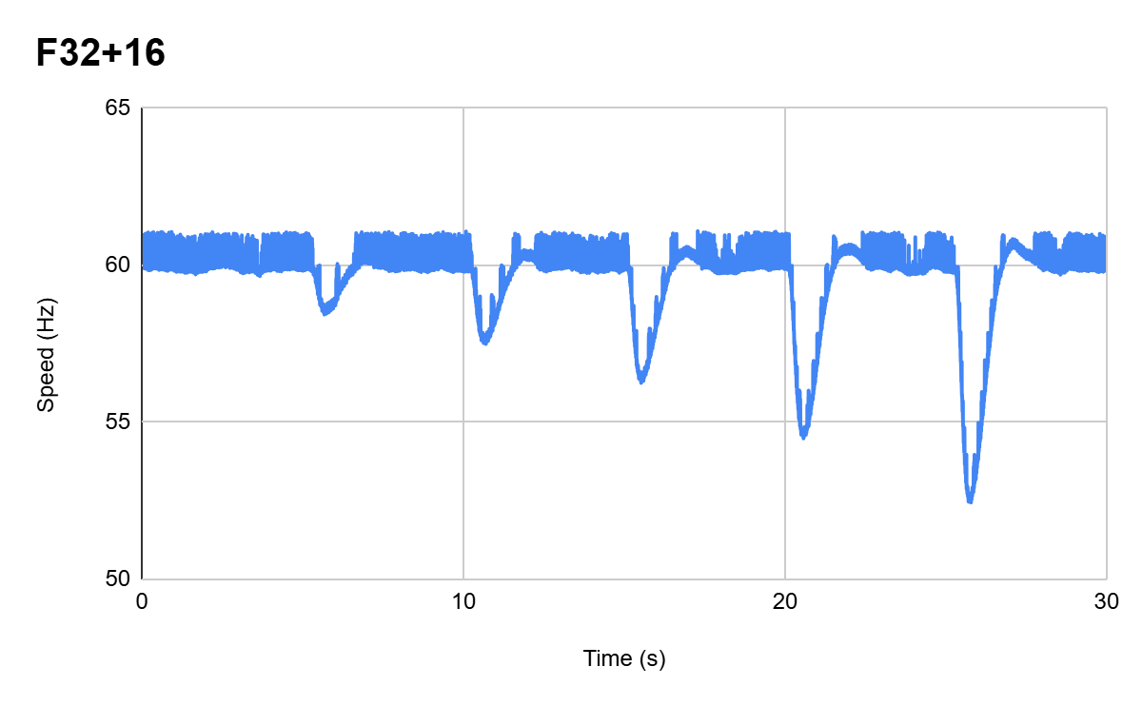
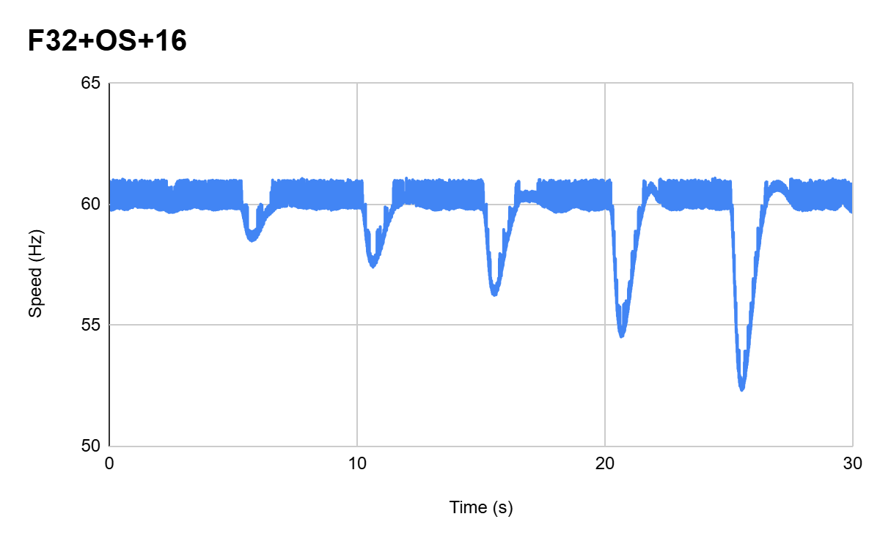

Slide 27
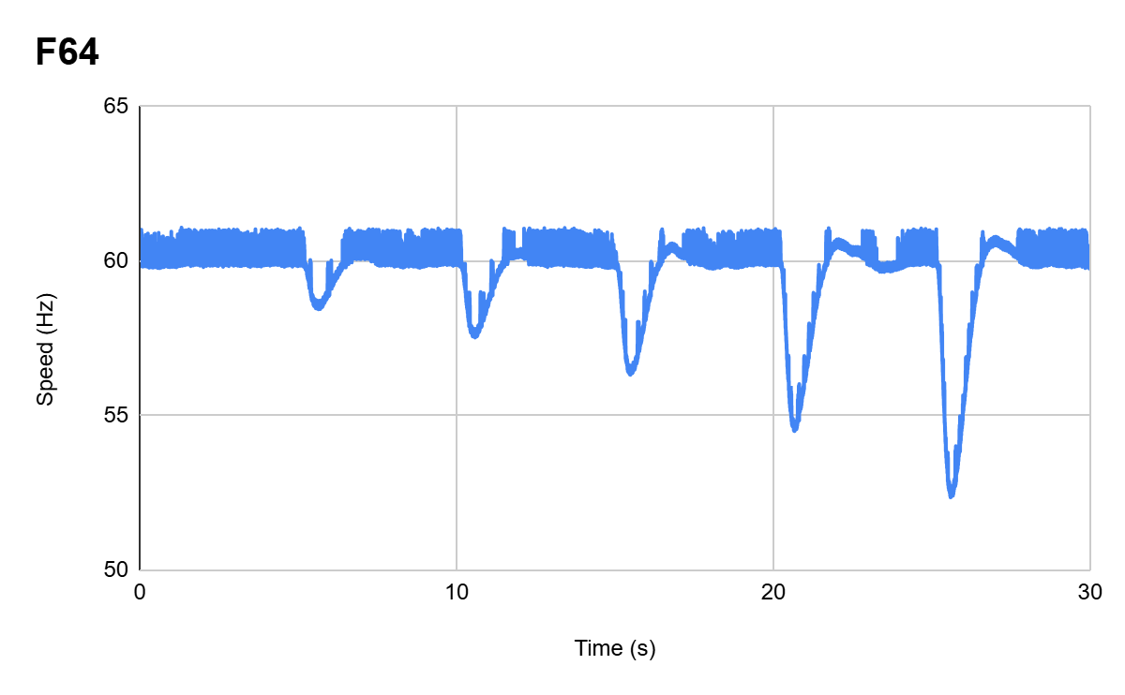

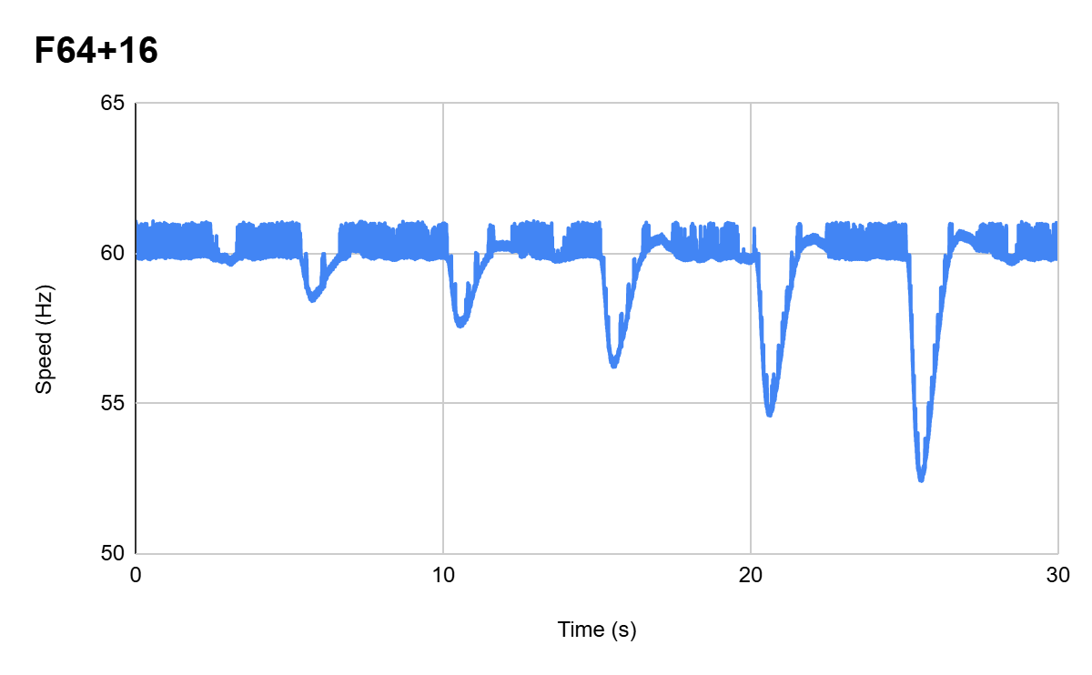
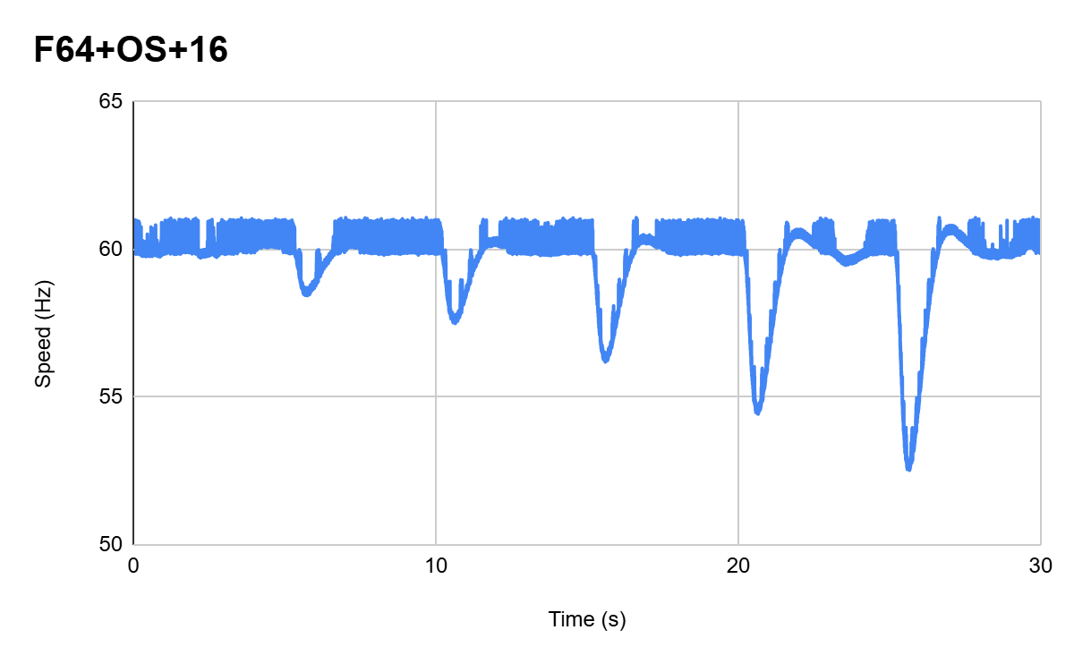

Slide 28
Conclusions
Our testing has been completed
Very little to no noticeable performance gain in all tested metrics
We verified our results by repeated testing to remove any errors or Inconsistencies

Slide 29
Validation Plan
Test Name | Success Criteria | Methodology | Status | Key
Porting Solution onto F28p65x board (requirement #1) | Ported motor control software onto f28p65x board successfully according to the Universal Motor Control Guide | Porting Solution onto F28p65x within Code Composer Studio (CCS) | Passed | Not Started
16-bit ADC resolution (requirement #2) | The system correctly operates using 16-bit ADC resolution according to the Universal Motor Control Guide | Implement 16-bit ADC on the ported solution using CCS | Passed | Passed
64-bit floating-point operation (requirement #4) | The system Correctly Operates using 64-bit Floating Point according to the Universal Motor Control Guide | Implement 64-bit operations on the ported solution using CCS | Passed | Tested
Enable oversampling (requirement #3) | The system Correctly Operates while oversampling is enabled according to the Universal Motor control guide | Implement oversampling on the ported solution using CCS | Passed
12-bit & 16-bit ADC resolution Support (requirement #2) | The system correctly operates using either 12-bit or 16-bit ADC resolutions according to the Universal Motor control guide | Implement a way to easily switch between configurations using CCS | Passed
32-bit & 64-bit floating-point support (requirement #4) | The system Correctly Operates using either 32-bit or 64-bit Floating Point according to the Universal Motor Control Guide | Implement a way to easily switch between configurations using CCS | Passed

Slide 30
Oversampling & non-oversampling support (requirement #3) | Operates using either oversampling or non-oversampling according to the Universal Motor Control Guide | Implement a way to easily switch between configurations using CCS | Passed
Test data acquisition (requirement #5) | The system correctly gathers test data for the following parameters: speed ripple, speed step, and load step. The data can be graphed, and differences or lack thereof should be visible. | Develop UART communication using CCS & Putty | Passed
Test 12 vs. 16-bit performance (requirement #5) | Test the performance of 12-bit and 16-bit ADC resolutions: speed ripple, speed step, load step. | Measure static speed, effects of load, speed changes & load changes on different configurations, and compare. Does x have more accurate average speed values, etc. | Passed
Test 32-bit & 64-bit Floating-point performance (requirement #5) | Test the performance of 32-bit and 64-bit ADC Floating point operations: speed ripple, speed step, load step. | Measure static speed, effects of load, speed changes & load changes on different configurations, and compare. Does x have more accurate average speed values, etc. | Passed
Test the performance of oversampling (requirement #5) | Test the effectiveness of oversampling: speed ripple, speed step, load step. | Measure static speed, effects of load, speed changes & load changes on different configurations, and compare. Does x have more accurate average speed values, etc. | Passed

Slide 31
Thanks & Gig’em
ADC Resolution vs. Sensorless Motor Control Performance

